Slide 1
Distracted Driver Classification
KISHORE KUMAAR NATARAJAN | 016013270 (Artificial Intelligence)
VARUN REDDY SEELAM | 016015948 (Software Engineering)
PRAVIN RAMASAMY BALACHANDRAN | 015443272 (Software Engineering)

Slide 2
INTRODUCTION
Distracted driving can easily cause accidents. According to National Highway Transportation and Safety Administration (NHTSA), distracted driving is causing about 3000 deaths and 280,000 injuries per year. Distracted driving has become all too common these days with advent of smart phones and social media.
We believe that computer vision based solutions can be effectively used to detect inattentive drivers using any sort of dashboard cameras and alert drivers. This report provides various DCNN Models we experimented and compared that can classify the driver action and predict if driver is distracted which can be further integrated with computer vision solution pipeline.
The 10 classes to predict are:
c0: normal driving
c1: texting - right
c2: talking on the phone - right
c3: texting - left
c4: talking on the phone - left
c5: operating the radio
c6: drinking
c7: reaching behind
c8: hair and makeup
c9: talking to passenger

Slide 3
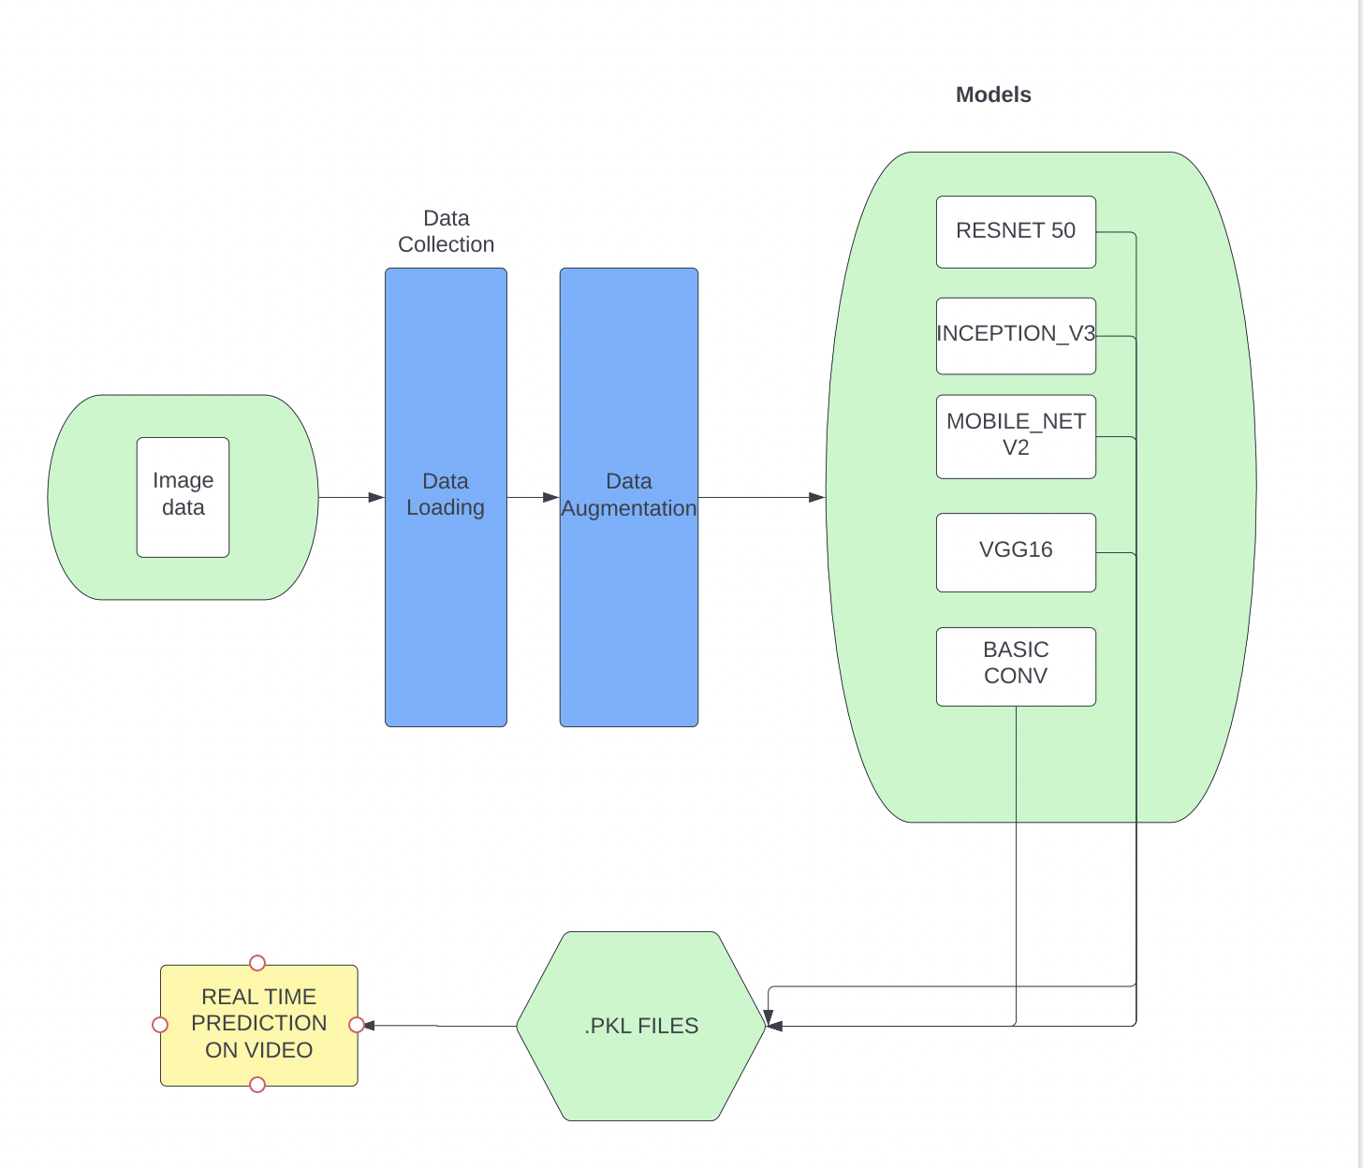
SYSTEM ARchitecture
Phase1: In phase-1 we collect the image data and load them as an array format and perform data augmentation on the data.
Phase 2: In phase-2 we build models using the image data and pick the best model out of the existing models.
Phase3: In phase 3, pick the best model out of the existing models and convert the model files into .pkl files so that we can use the model weights to implement them in the real time system.

Slide 4
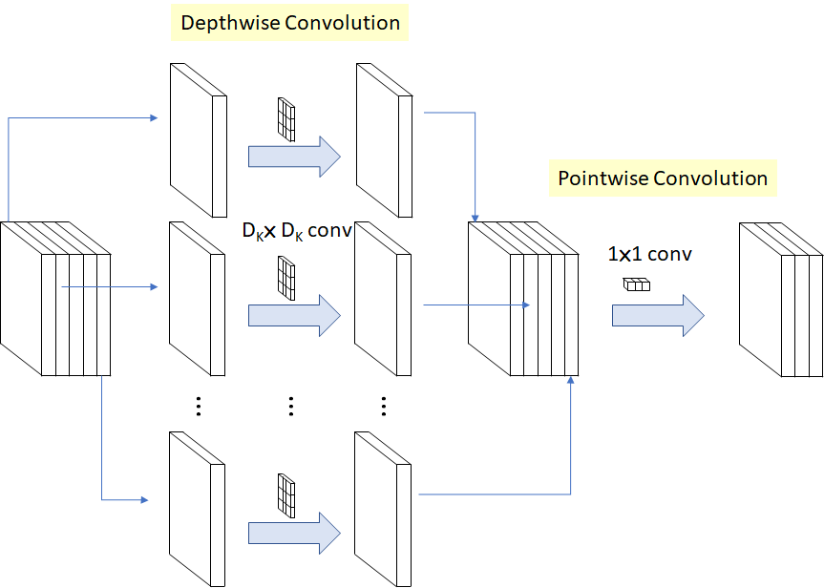
MOBILENet

Slide 5
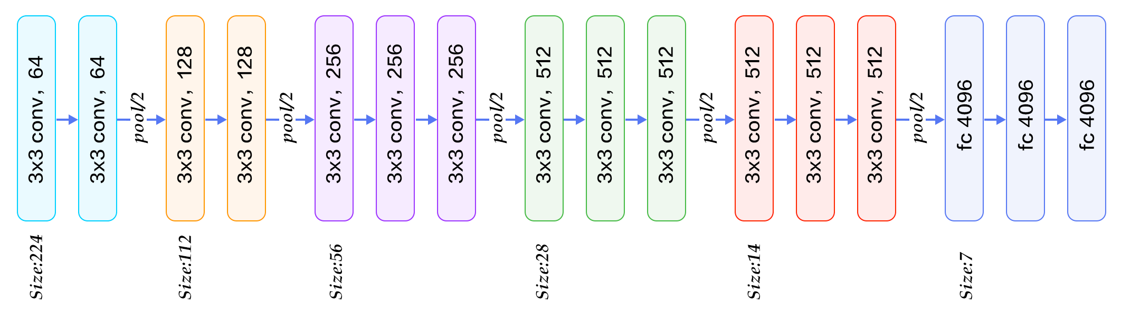
VGG16

Slide 6
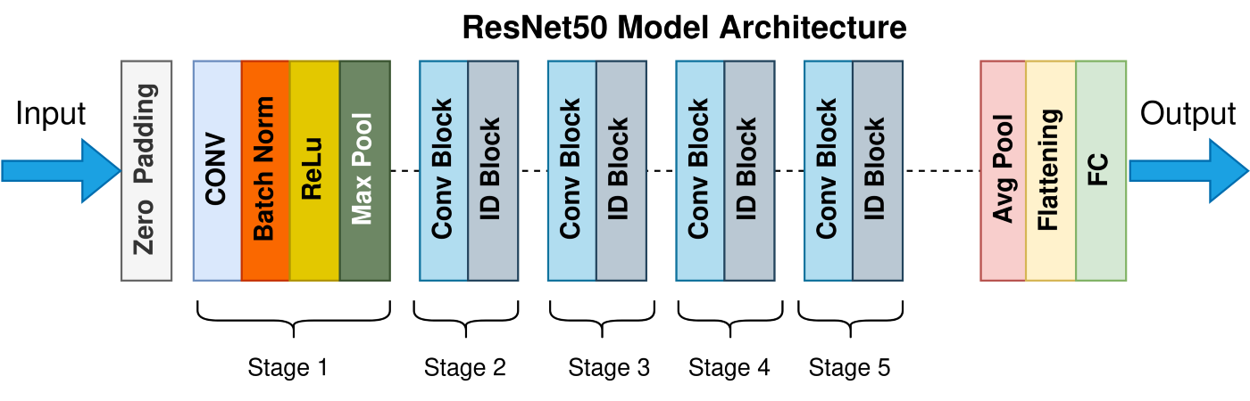
RESnet 50

Slide 7
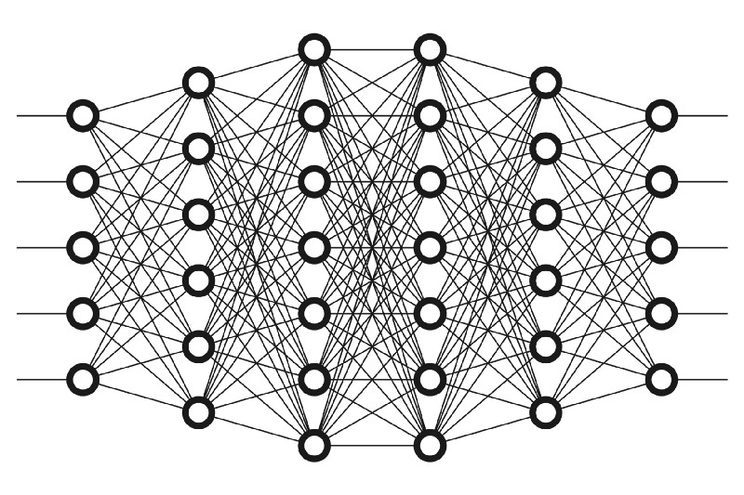
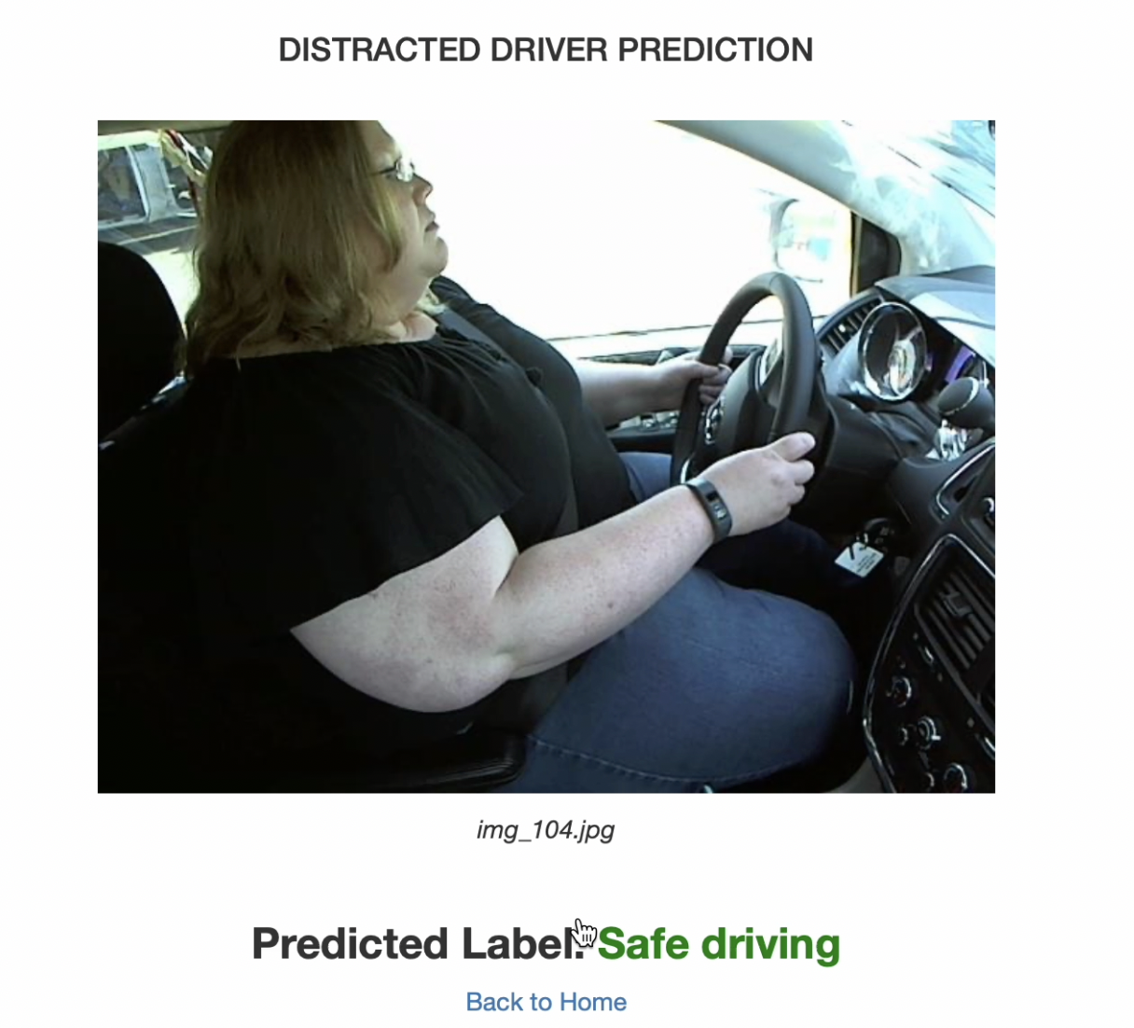
Real TIme Working

Slide 8
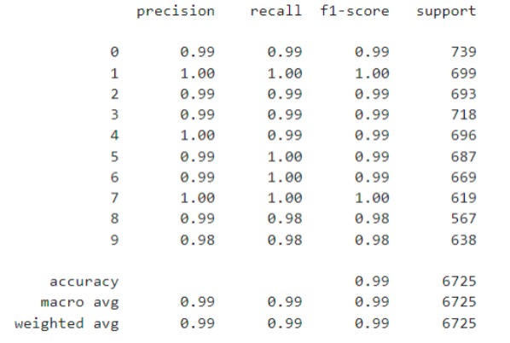
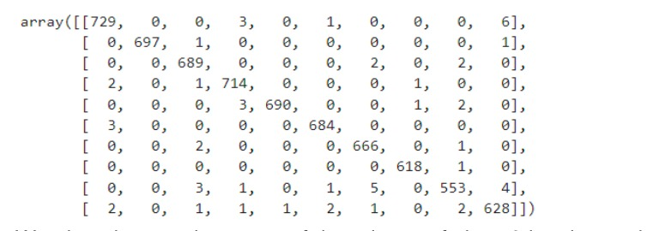
RESULTS

